Slide 1

Predicting Whether a Bank Client Will Subscribe For a Term Deposit
09/23/2022

Slide 2

Objectives and Approach
Problem Description/Objectives : ABC Bank wants to sell its term deposit product to customers and before launching the product they want to develop a model which helps them in understanding whether a particular customer will buy their product or not (based on customer's past interaction with bank or other Financial Institution).
Approach: To predict whether a customer will subscribe for a term deposit, we will use the following techniques:
Exploratory Data Analysis
Logistic Regression
Machine Learning Methods (Random Forest, Artificial Neural Network, Support Vector Machine, Naive Bayes Classifier)

Slide 3
Data
Target Variable: The target variable that we are trying to predict is ‘y’, which takes a value of 1 if a customer subscribes for a term deposit and 0 if they do not subscribe.
Features: There are a total of 16 features
7 Numerical features (age, balance, etc.)
9 Categorical features (job, marital status, etc.)

Slide 4
Potential Problems with the Data
Missing Values: In both of our datasets, we did not find any missing or NA values, so there was no need to deal with missing values.
Outliers: Most numeric variables in the dataset contained many outliers.
Skewness: Many of the numeric variables in the dataset were skewed, including ‘pdays’, ‘duration’, ‘campaign’, ‘previous’, and ‘balance’.

Slide 5
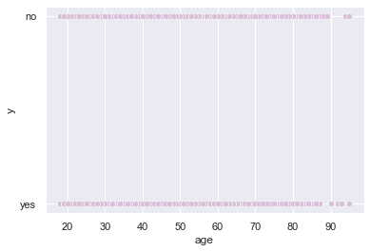
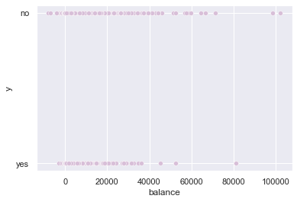
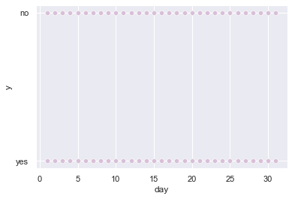
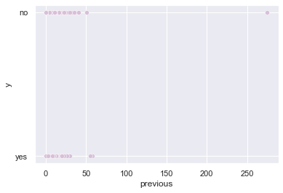
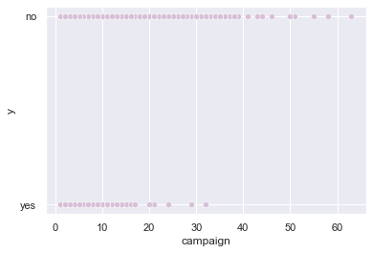
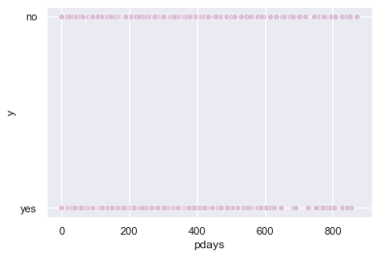
Identifying Outliers and Skewness

Slide 6
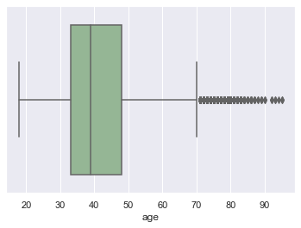
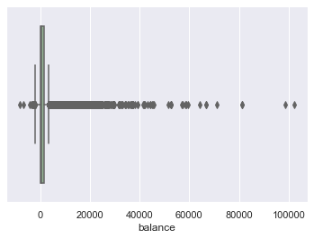
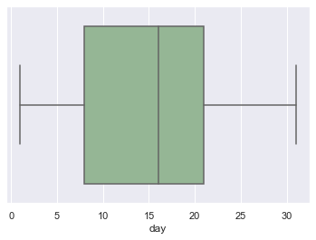
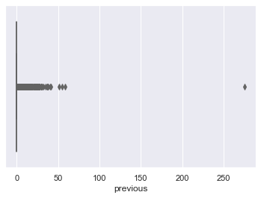
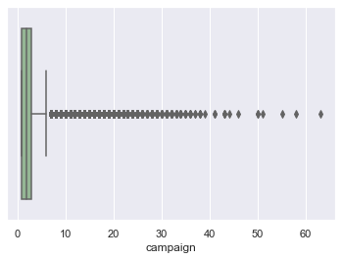
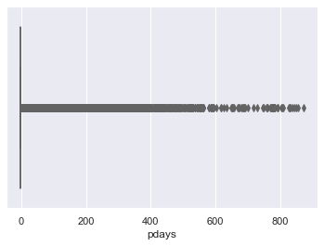
Identifying Outliers and Skewness Cont.

Slide 7
Data Cleaning

Slide 8
Data Cleaning

Slide 9
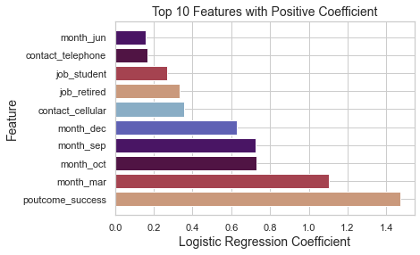
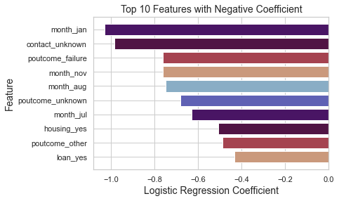
Logistic Regression Model

Slide 10
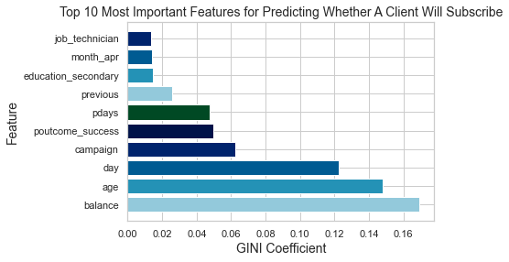
Random Forest

Slide 11
Support Vector Machine

Slide 12
Naïve Bayes' Classifier

Slide 13
Artificial Neural Network

Slide 14
Model Evaluation: Selecting the Best Model

Slide 15
Model Evaluation: Selecting the Best Model

Slide 16
Results

